Slide 1
Visual Question Answering Sprint 2
Group #16 Yi Yang, Qilong Wang

Slide 2
1.Sprint 2 Goal
Run the code on colab
Try to adjust the dataset to the blind vqa dataset and add a new classification to deal with the low-quality pictures.

Slide 3
2.Achievement
Upload the VQA code to the BU SCC
Speech-to-text API
Dataset: Vizwiz dataset

Slide 4
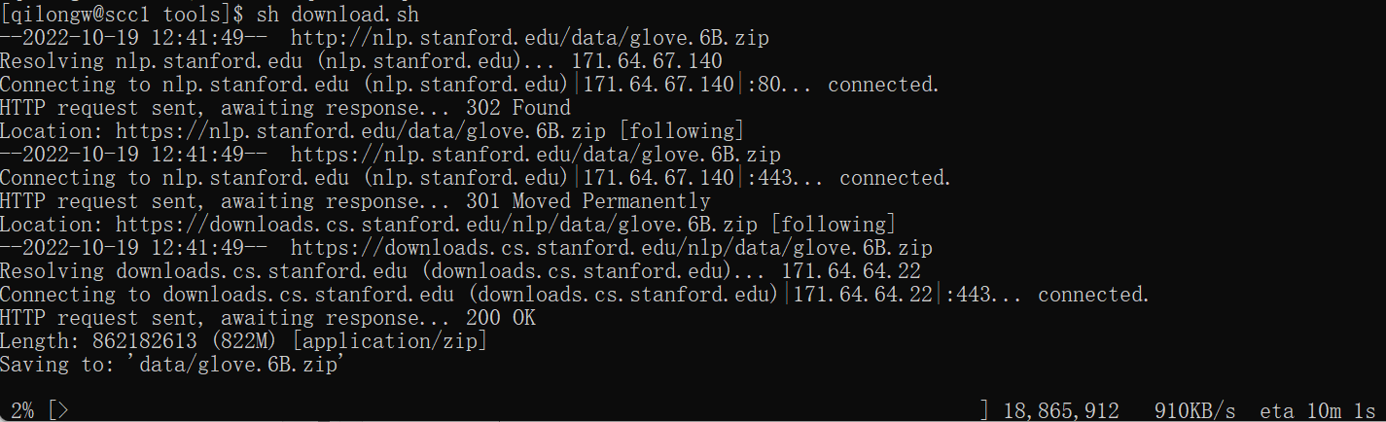
2.Achievement-Code
Code uploaded to BU SCC – done
Environment
-anaconda - done
-pytorch and cuda - still installing
Introducing pre-trained features – done
Run the code and duplicate the result – not done

Slide 5
2.Achievement-Speech-to-Text API
Pattern: Synchronous Recognition
Still working on its usage in python

Slide 6
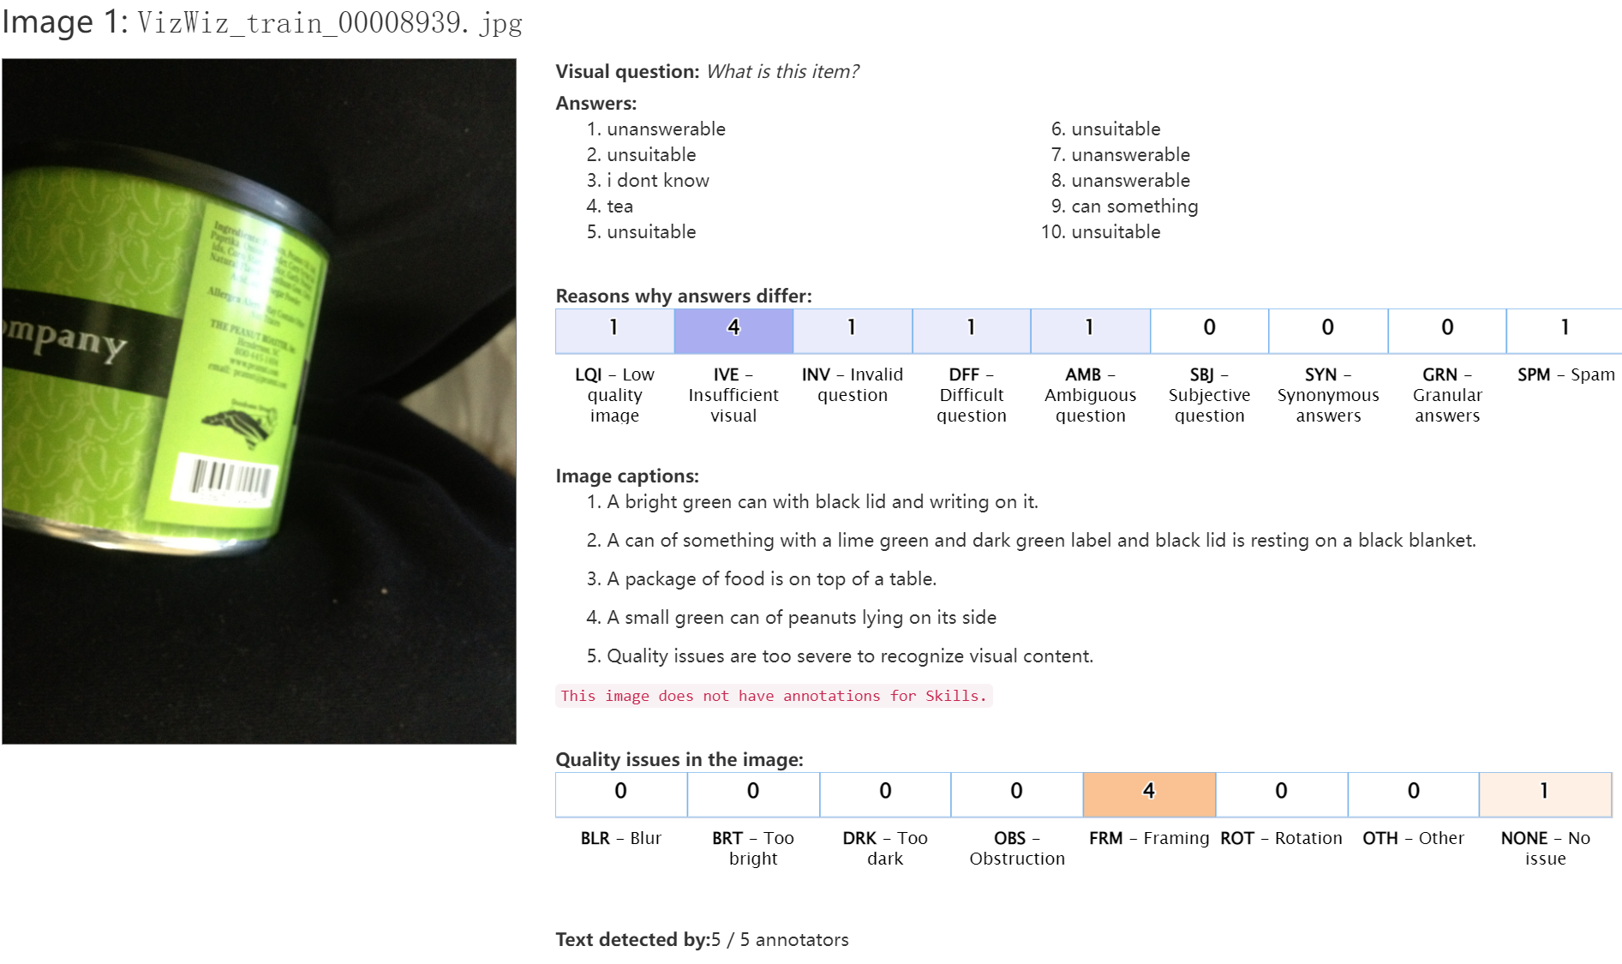
2.Achievement-Dataset
A VQA dataset for blind people – Vizwiz
The data form is different from COCO dataset, still working on replacing COCO with Vizwiz.

Slide 7
3.Next Sprint goals
1.code: construct the environment and run the code
2.Apply the vizwiz dataset in the model. At least make the model recognize the “unanswerable” kind of pictures. Furthermore, trying to use vizwiz dataset as train set (vizwiz do not have a pre-trained feature so it may take longer time). Also, trying to replace “unanswerable” question into detailed instruction like “try to move up the camera”.
3.Apply speech-to-text in python. Furthermore, try to connect the model and the api.

Slide 8
Thanks

